Slide 1
Azure Red Hat OpenShift (ARO)
14
Cluster Upgrade
Automation Framework
PRE-UPGRADE CHECKS
6
Deterministic multi-hop lifecycle management with closed-loop validation, remediation, drift assurance and reporting.
AUTO-REMEDIATIONS
24
MODULAR ROLES
Executive client summary | Version 1.0.0-PROD | Target OCP 4.12 → 4.14+
Notes:
[Sources] - Source: ARO_Cluster_Upgrade_Client_Presentation.pptx, provided by the user. [/Sources]

Slide 2
WHY AUTOMATE
Business problem and measurable value
Manual upgrades combine long monitoring windows, sequencing risk and incomplete audit evidence.
Current risks
Outcome with the framework
Sequential minor-version upgrades require accurate channel and hop selection.
Pending CSRs, cordoned nodes, MCP instability and operator skew can block progress.
Manual sessions provide limited baseline comparison and fragmented audit evidence.
One-touch, fail-closed execution across required OpenShift Y-stream hops.
Automated monitoring, safe remediation and post-upgrade health verification.
Immutable JSON snapshots, structured drift analysis and executive reporting.
Single trigger
Zero AI
No outage
Pre/Post diff
ENGINEER INVOLVEMENT
EXECUTION MODEL
SERVICE GOAL
AUDIT OUTPUT
Notes:
[Sources] - Source: ARO_Cluster_Upgrade_Client_Presentation.pptx, provided by the user. [/Sources]

Slide 3
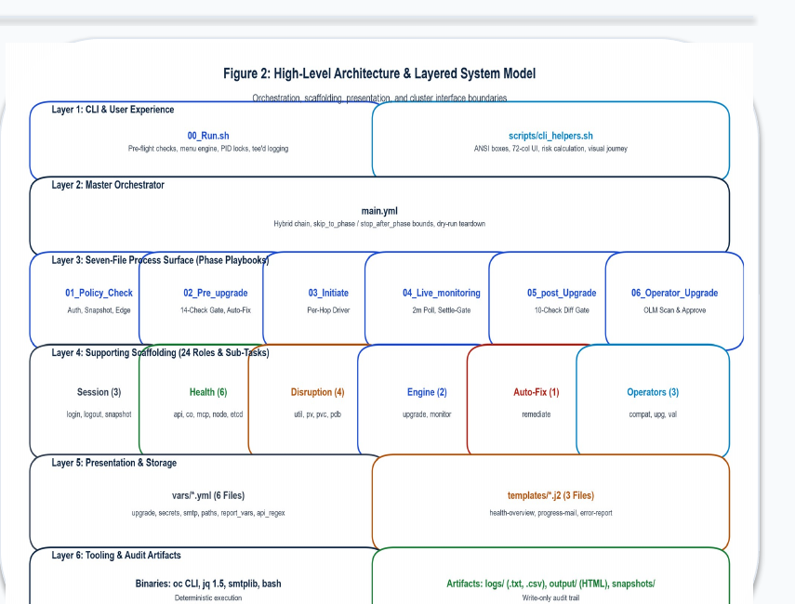
ARCHITECTURE
Layered orchestration with clear execution boundaries
Operations use simple wrappers while all cluster interactions remain inside modular Ansible roles.
Shell surface: 00_Run.sh through 06_Cleanup.sh for full or phase-specific execution.
main.yml coordinates six phases, shared facts, rescue logic and teardown.
24 single-responsibility roles cover validation, remediation, upgrade, monitoring and reporting.
OpenShift API interactions flow through Ansible roles to CVO, MCO and OLM.
PID locking prevents concurrent runs and protects state artifacts.
Notes:
[Sources] - Source: ARO_Cluster_Upgrade_Client_Presentation.pptx, provided by the user. [/Sources]

Slide 4
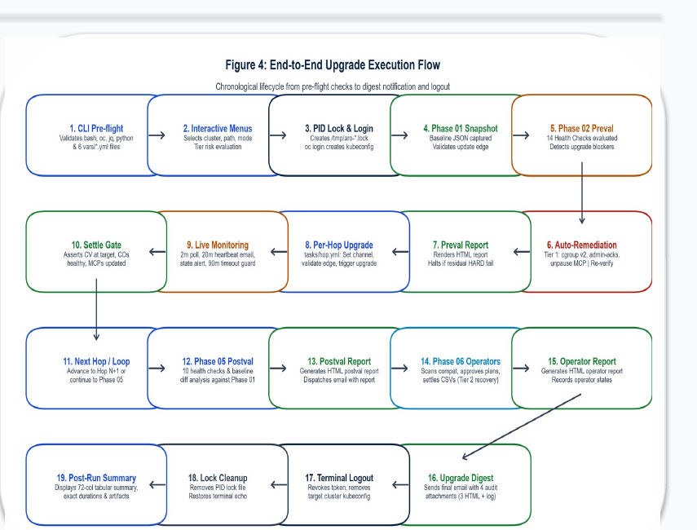
EXECUTION LIFECYCLE
Closed-loop multi-hop upgrade workflow
Each hop must fully settle before the framework advances to the next minor version.
Six gated phases
Pre-validate and capture baseline.
Apply deterministic remediation, then re-check.
Build and execute the valid Y-stream hop path.
Poll CVO, operators and MCPs every 30 seconds.
Synchronize Day-2 operators after core stability.
Post-validate, diff and report.
Fail closed: no next hop if the settle gate fails.
Notes:
[Sources] - Source: ARO_Cluster_Upgrade_Client_Presentation.pptx, provided by the user. [/Sources]

Slide 5
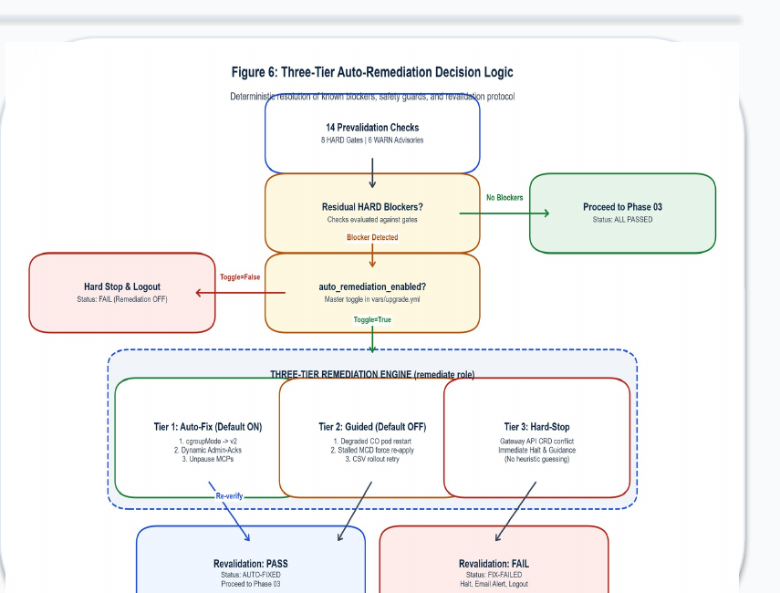
RELIABILITY
Validation, settlement and state assurance
Automation only fixes known, non-disruptive conditions and verifies the same health baseline after upgrade.
Pre-validation and safe fixes
14 checks: nodes, ClusterOperators, MCPs, etcd, CSRs, PVCs, API and capacity.
6 rule-based fixes include CSR approval, evicted pod cleanup and node uncordon.
Persistent or non-remediable issues stop execution before cluster mutation.
Settlement equation
CVO completed + all operators healthy + MCP updated = ready
Notes:
[Sources] - Source: ARO_Cluster_Upgrade_Client_Presentation.pptx, provided by the user. [/Sources]

Slide 6
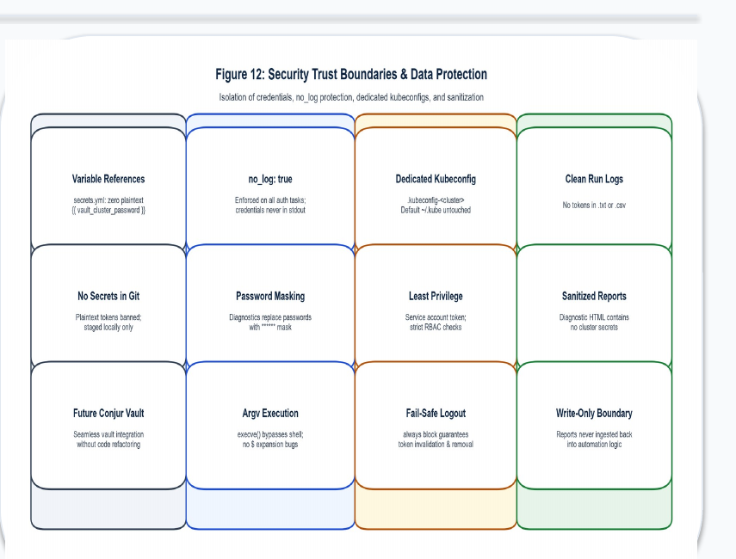
ENTERPRISE CONTROLS
Security, risk handling and production readiness
The design prioritizes cluster stability, credential safety and auditable failure handling.
Built-in controls
Least-privilege ServiceAccount RBAC and ephemeral authentication tokens.
Secrets via environment variables or Ansible Vault with no_log guardrails.
Atomic snapshot writes, controlled scratch storage and cleanup on interruption.
Hard stop for etcd degradation, failed hop settlement or active process lock.
Production readiness: 92%
Remaining: staging soak test, proxy timeout tuning and CAB runbook sign-off.
Notes:
[Sources] - Source: ARO_Cluster_Upgrade_Client_Presentation.pptx, provided by the user. [/Sources]

Slide 7
ROLLOUT
Deployment, operating modes and next steps
A controlled staging pilot should precede operational handover and production fleet rollout.
Controller prerequisites
Recommended rollout
Enterprise Linux controller with Python 3.8+, Ansible 2.7.17 or 2.14.18+, oc and jq.
Network access to ARO API 6443/TCP, Azure 443/TCP and enterprise SMTP.
Supports private ARO connectivity through bastion, VPN or ExpressRoute.
Staging pilot
1
Exercise multi-hop flow, workload continuity, snapshots and email reporting.
SRE handover
2
Walk through runbook and simulate known blockers.
Operating modes
Full lifecycle: ./00_Run.sh
Validation-only and --dry-run modes
Resume, stop-after-phase and forced cleanup controls
Production rollout
3
Use approved maintenance windows and monitor Day-2 operator alignment.
Decision gate: complete staging evidence and CAB approval before production.
Notes:
[Sources] - Source: ARO_Cluster_Upgrade_Client_Presentation.pptx, provided by the user. [/Sources]

